Slide 1
DevOps Methodology and Monolithic vs. Microservices
Medi Servat
INFO6255
Fall 2019

Slide 2
Monolithic vs Microservice
What is the Monolithic Architecture?
a single logical executable. To make any alterations to the system, a developer must build and deploy an updated version of the server-side application.
What is a Microservice Architecture
It structures an application as a collection of loosely coupled services. In a microservices architecture, services are fine-grained and the protocols are lightweight.

Slide 3
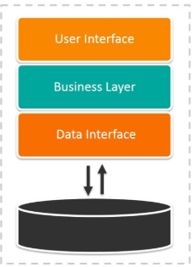
Monolithic Architecture
A Layered Architecture consisting of:
Presentation layer – HTTP requests
Business Logic layer
Database layer
Integration Services – REST API
The application gets packaged and deployed as a Monolith.
https://articles.microservices.com/monolithic-vs-microservices-architecture-5c4848858f59

Slide 4
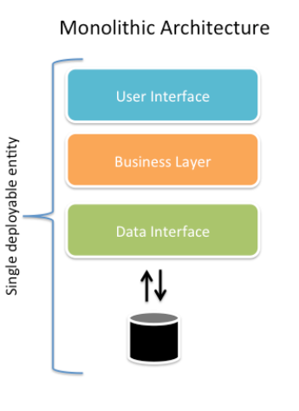
Monolithic Architecture
Advantages:
Easy Development
Easy Testing
Easy Deployment
Simple to scale out
Dis-Advantages:
Limitation in size
The application is too large and complex
Impact of change is not easy to understand
Reliability may be an issue
Not easy to adopt new technologies
https://articles.microservices.com/monolithic-vs-microservices-architecture-5c4848858f59

Slide 5
Microservices Architecture
The application is split into a set of smaller, interconnected services.
Each microservice is a small application with its own architecture.
Each Microservice may have its own database of different types.
Communication of the microservices is mediated using an API Gateway.
API Gateway: Load Balancing, Caching, Access Control, API Metering, and Monitoring.
https://articles.microservices.com/monolithic-vs-microservices-architecture-5c4848858f59

Slide 6
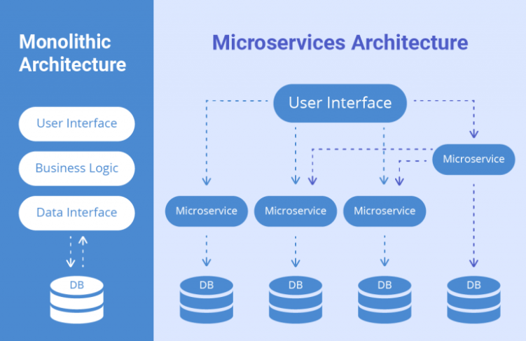
https://www.sam-solutions.com/blog/microservices-vs-monolithic-real-business-examples/

Slide 7
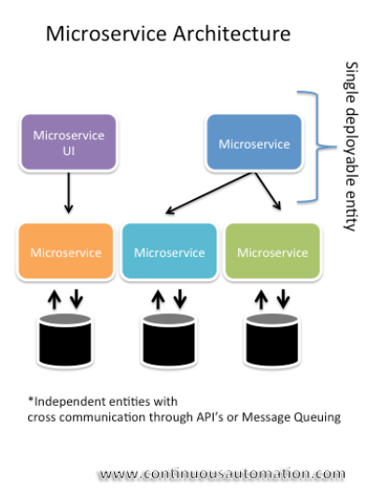
Microservices Architecture
Advantages:
Addresses the problem of Complexity.
Enables the deployment each service independently.
It opens the development to adopt new technologies (not locked in).
It allows continuous deployment as each service is independent.
It allows scaling of the Microservices independently.
Dis-Advantages:
It is distributed system. Distributed systems are harder to develop and test.
Partitioned Databases. Multiple databases have to get updated.
Testing is more complex. Testing a service you would need to launch that service and any services that it depends on.
Deploying a microservices-based application is also more complex.
https://articles.microservices.com/monolithic-vs-microservices-architecture-5c4848858f59

Slide 8
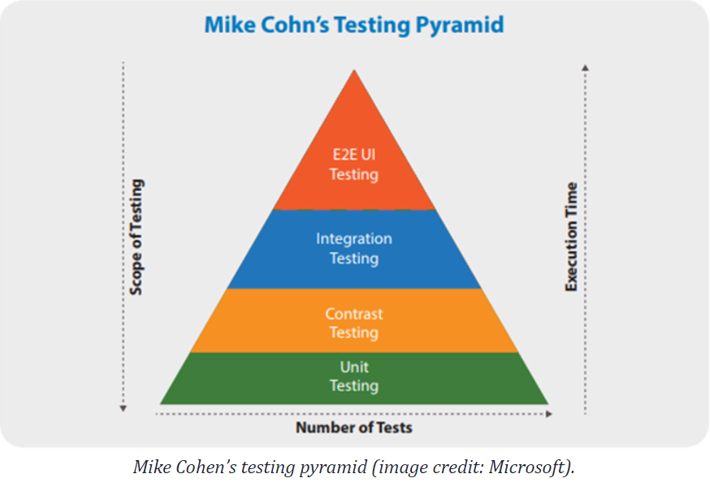
Testing Microservices Architecture
Unit Testing: the testing is internal to the Service, and should be automated.
Contract Testing: A “contract” is how a service call is referred to by the consumer-contract testing.
Every “consumer” must receive the same results from a service.
Integration Testing: Verification of the services that have been individually tested.
It validates that the system is working together seamlessly and that the dependencies between the services are present as expected.
https://www.cigniti.com/blog/5-approaches-for-automating-microservices-testing/

Slide 9
Testing Microservices Architecture
End to End Testing : verifies that the entire process flows work correctly, including all service and DB integration.
Includes testing multiple services to ensure that the system works well together.
Functional Testing (UI): testing of the User Front End as it tests the system as an end-user would use it.
All the databases, interfaces, internal and third-party services must work together seamlessly to produce the expected results.
https://www.cigniti.com/blog/5-approaches-for-automating-microservices-testing/

Slide 10
DevOps Methodologies
DevOps: The DevOps methodology is the newcomer to the SDLC scene.
It emerged from two trends:
The application of Agile and Lean practices to operations work
The general shift in business toward seeing the value of collaboration between development and operations staff at all stages of the SDLC process

Slide 11
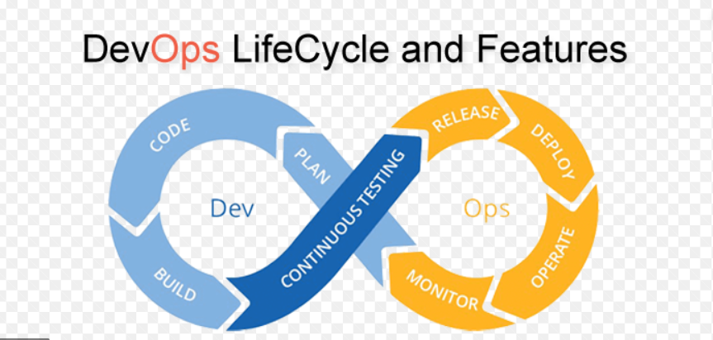
More on DevOps Model
The high pace of code builds per day delivering stability and reliability.
The DevOps model is to:
Development writes the code.
Development Automatically deploys the code into the Automated Test environment.
Test team execute Automated Tests.
Deploys into the production environment.

Slide 12
DevOps Principals
DevOps practices include:
Self-service configuration.
Automated provisioning.
Continuous build.
Continuous integration.
Continuous delivery.
Automated release management.
Incremental testing.
https://www.guru99.com/agile-vs-devops.html

Slide 13
DevOps
DevOps Summary:
DevOps is a software development method which focuses on communication, integration, and collaboration among IT professionals.
DevOps consider as a practice of bringing development and operations teams together.
In the DevOps, process documentation is foremost because it will send the software to the operational team for deployment.

